Slide 1
IF YOU WANT TO GO FAST, GO ALONE IF YOU WANT TO GO FAR, GO TOGETHER!!
- African Proverb

Slide 2

ROUTING PROTOCOLS IMPLEMENTED IN A COMPANY NETWORK
By:
Ashish Kumar
Student ID: 108998404
singh.ashish.kr96@gmail.com
INTERNATIONAL GRADUATE PROGRAM IN ELCTRICAL ENGINEERING AND COMPUTER SCIENCE (IEECS) Department
NATIONAL TAIPEI UNIVERSITY OF TECHNOLOGY, TAIPEI, TAIWAN

Slide 3
TOPICS TO BE COVERED
INTRODUCTION
STATIC & DYNAMIC ROUTING
RIP
RIP V1
RIP V2
IGRP
EIGRP
OSPF
CISCO PACKET TRACER
RELIABLE TRANSPORT PROTOCOL
SIMPLE SCENARIO SHOWING RIP ROUTING PROTOCOL
WAITING FOR ROUTER TO GET BOOTED
ROUTER BOOTED AND READY TO WORK ON
PROVIDING IP ADDRESS TO PC
PROVIDING GATEWAY TO PC

Slide 4
PROVIDING GATEWAY IP TO ROUTER ALPHA FOR COMMUNNICATION WITH PC
ROUTER BETA GATEWAY SET
SERIAL PORT ENABLING IN ROUTER ALPHA
SERIAL PORT ENABLING IN ROUTER BETA
WITHOUT ROUTING PROCOL ROUTERS ARE NOT ABLE TO COMMUNNICATE
CONFIGURUNG RIP IN ROUTER ALPPHA
CONFIGURING RIP IN ROUTER BETA
RIP WORKING – PC & ROUTERS ABLE TO SEND & RECEIVE PACKETS
SIMULATION PACKAGE SENDING AND RECEIVING
ACKNOWLEGEMENT RECEIVED
COMPLEX SCENARIO

Slide 5
INTRODUCTION
ROUTING PROTOCOLS
These are set of rules and regulations used by the router to communicate between the source and destination.
Data is not moved routing tables are updated.
Each router has a prior knowledge only of networks attached to it directly.
A routing protocol shares this information first among immediate neighbours, and then throughout the network.
This way, routers gain knowledge of the topology of the network.

Slide 6
The ability of routing protocols to dynamically adjust to changing conditions such as disable data lines and computers and route data around obstructions is what gives the internet its survivability and reliability.
Specific characteristics of routing protocols include:
The manner in which they avoid routing loops
The manner in which they select preferred routes, using information about hop costs, the time they require to reach routing convergence, their scalability, and other factors.
The data is send via metric values that are :-
Bandwidth
Delay
Load
Reliability

Slide 7
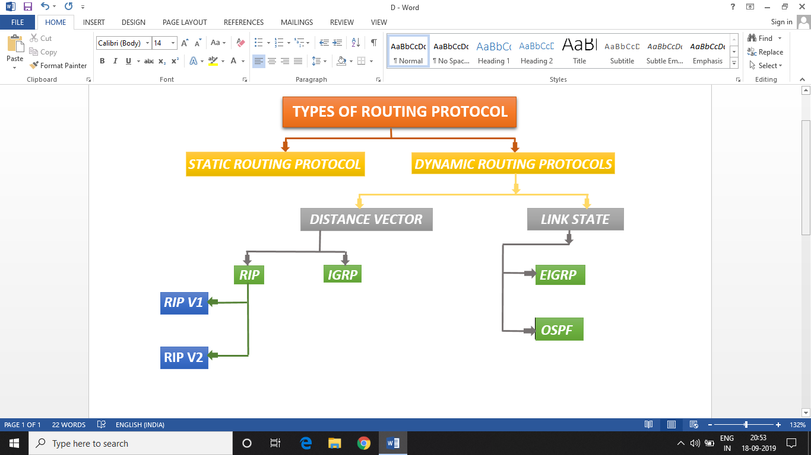

Slide 8
Static Routing
A router with manually configured routing tables is known as a static router.
A network administrator, with knowledge of the internetwork topology, manually builds and updates the routing table, programming all routes in the routing table.
Advantages
Fast and efficient.
Less overhead for router.
Disadvantage
Static routers can work well for small internetworks but do not scale well to large or dynamically changing internetworks due to their manual administration.

Slide 9
Dynamic Routing
Router with dynamically configured routing tables is known as a dynamic router.
It consists of routing tables that are built and maintained automatically through an ongoing communication between routers.
This communication is facilitated by a routing protocol.
Advantages
More scalable
Configuration is less-prone.

Slide 10
Types of Dynamic Routing Protocols
There are two types of Dynamic Routing Protocols.
(1) Distance Vector Routing - The Routing, which is based on two parameters,
That is distance and direction is called Distance Vector Routing.
The example of Distance Vector Routing is RIP & IGRP.
(2) Link State Routing - It uses sophisticated algorithms that maintain a
complex database of internetwork topology.
The example is Enhanced interior Gateway
Routing Protocol (EIGRP) & Open Shortest Path First (OSPF).

Slide 11
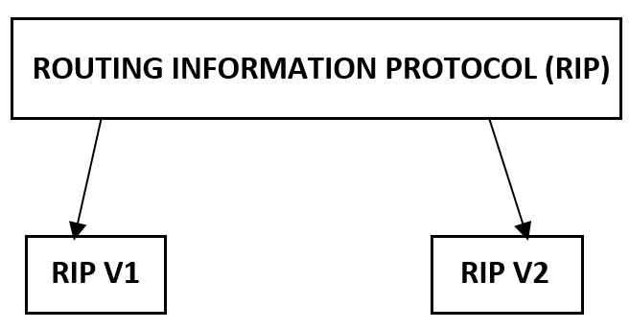
Routing Information Protocol (RIP)
Routing Information Protocol (RIP) is a true distance-vector routing protocol.
It was made by Bellman Ford also known as Bellman Ford algorithm.
Features:
Distance Vector Routing Protocol
Maximum Reachable hop-count is 15
Hop 16 is considered unreachable
Update time of 30 seconds
Hold time taken by rip is 180 seconds (receiving data time)
Flush time of 240 sec

Slide 12
RIP Version 1
Open standard protocol - works on all routers
Classfull routing protocol – No Subnetting
Updates are broadcasted via 255.255.255.255
Administrative distance 120
Advantage:
Load balancing is there if paths are equal
Easy to configure
No complexity
No design constraints
Disadvantage:
Bandwidth utilization is very high (update time 30 sec)
Max routers 15
Works only on hop count
Slow convergence – Finding second path to transfer data

Slide 13
RIP Version 2
Open standard protocol
Classless routing protocol
Support Variable Length Subnet Masking(VLSM)
Auto summery can be done on every router
Support authentication
Trigger updates
Uses multicast address 224.0.0.9

Slide 14
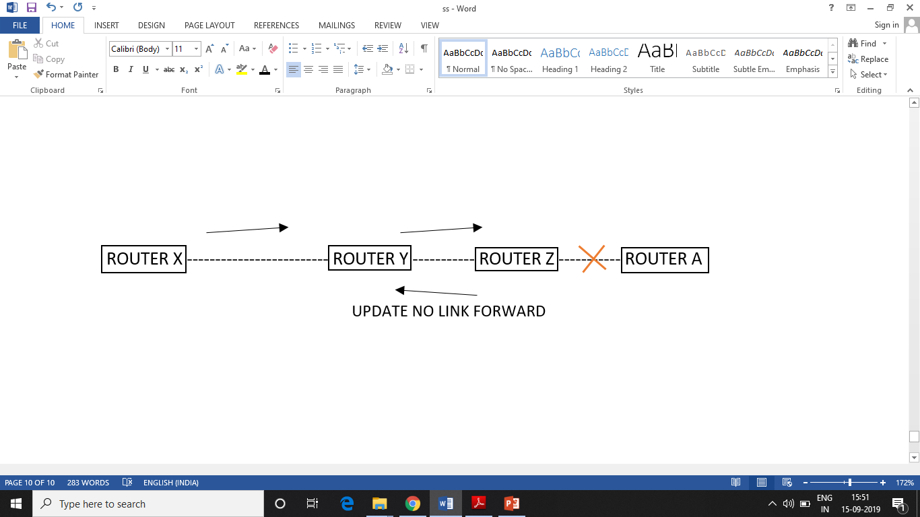
SPLIT HORIZON:
Router never send information about a route back in same direction from where original information came.
Routers keep a track from where information about route came from.
ROUTE POISONING:
Router consider route advertised within infinitive metric to have failed(metric 16) instead of marking it down.
POISON REVERSE:
Poison reverse rule overwrites split horizon.

Slide 15
Interior Gateway Routing Protocol (IGRP)
IGRP is a distance vector protocol. To overcome the limitation of rip, igrp is used.
It can only work on cisco routers.
Features
Update time is 90 seconds
Uses multipath routing
Fastest among dynamic protocols

Slide 16
Enhanced Interior Gateway Routing Protocol (EIGRP)
EIGRP is sometimes referred to as a hybrid routing protocol because it has characteristics of both distance-vector and link-state protocols.
It works fastest on cisco routers and it is a cisco propriety priority working protocol.
Features of EIGRP: -
Hybrid protocol
For EIGRP it can have maximum 255 routers hop count
Hop count 256 is unreachable
Reliability

Slide 17
Open Shortest Path First Protocol (OSPF)
OSPF can work on any router.
Here large network can be broken into small areas on the basis of area its network is designed.
Features: -
Link State Routing Protocol
Hierarchical model
Metric is Bandwidth
Update table in every 30 minutes
Supports unlimited hop count

Slide 18

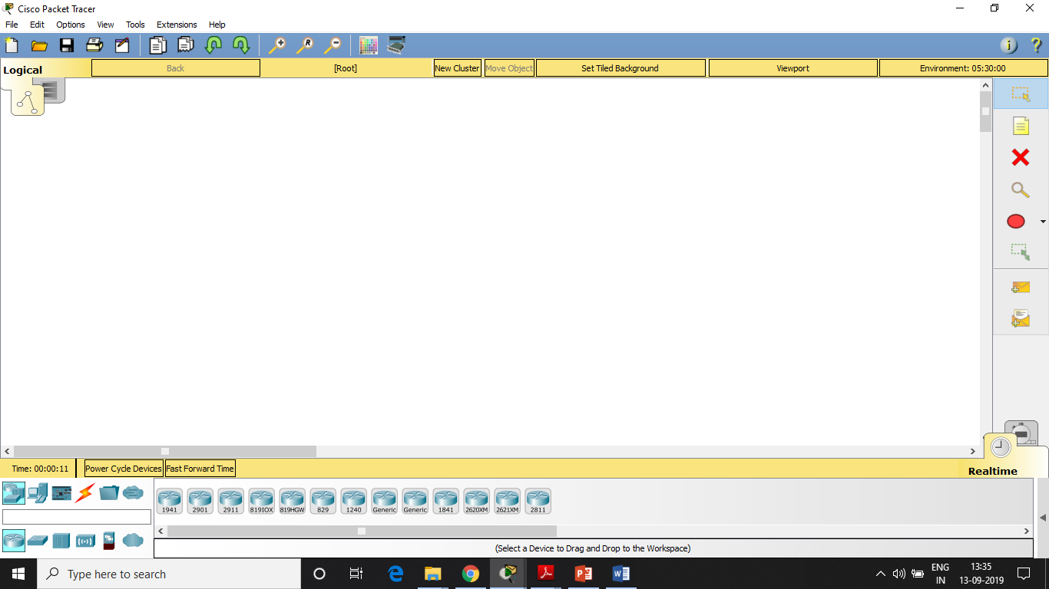
CISCO PACKET TRACER
Developer(s) | Cisco Systems
Stable release | 7.2.1
Operating system | Linux, Android 4.2+, iOS 8+ and Microsoft Windows, macOS
Platform | Windows, Linux, Android (operating system), iOS, macOS
Available in | English, Russian, German, Portuguese, Spanish and French
License | Proprietary(closed source software)
Cisco Packet Tracer
Packet Tracer 7 in Windows 10

Slide 19
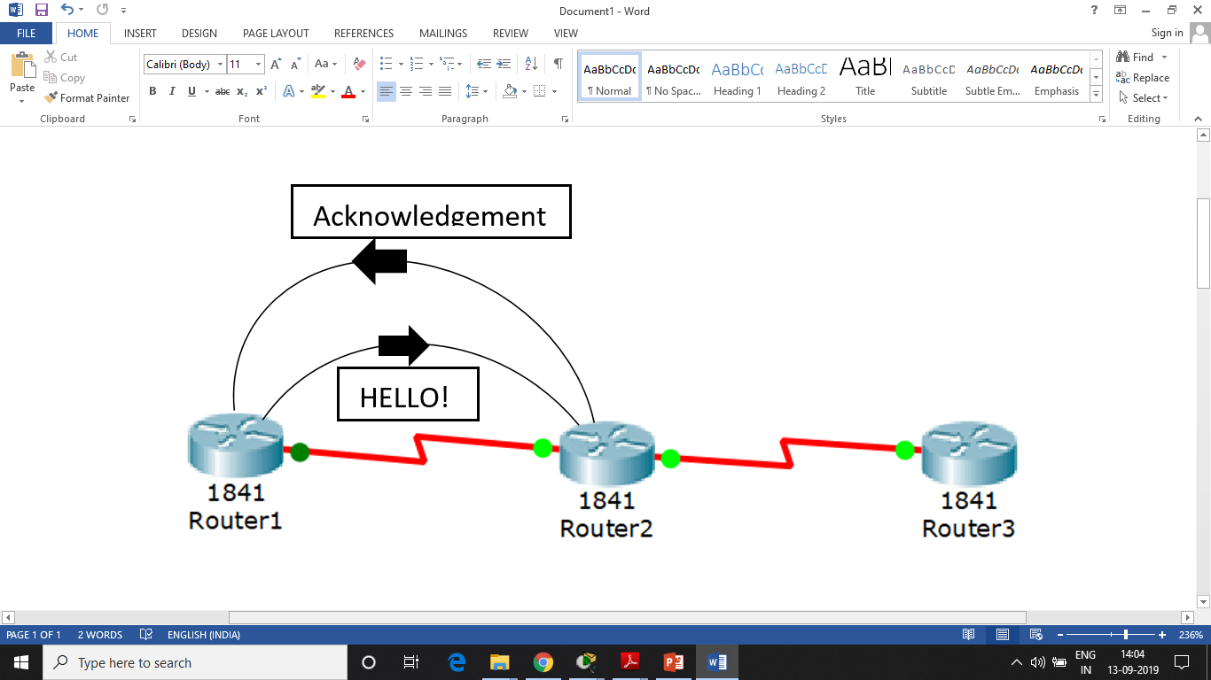
RELIABLE TRANSPORT PROTOCOL
Every router sends other router a “Hello” message every 10 sec.
This leads to creation of a session.
This tells router if the interface id down or not.
Acknowledgment with 40 sec is must.

Slide 20
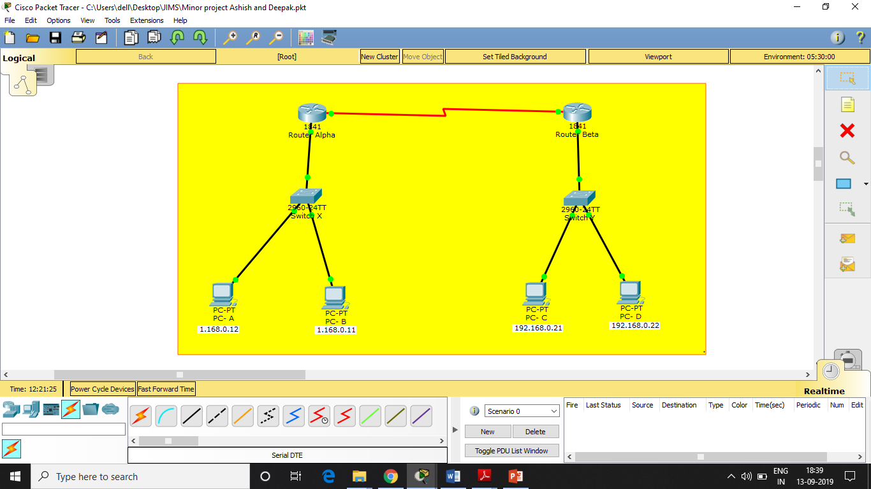
SIMPLE SCENARIO SHOWING RIP ROUTING PROTOCOL

Slide 21
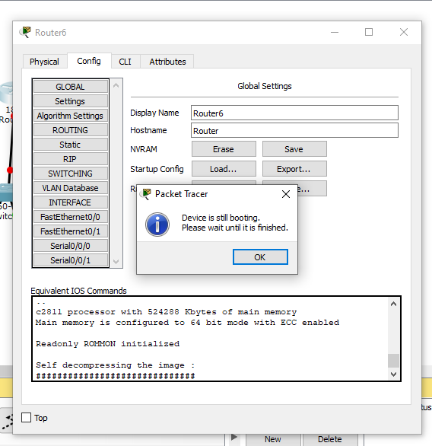
WAITING FOR ROUTER TO GET BOOTED

Slide 22
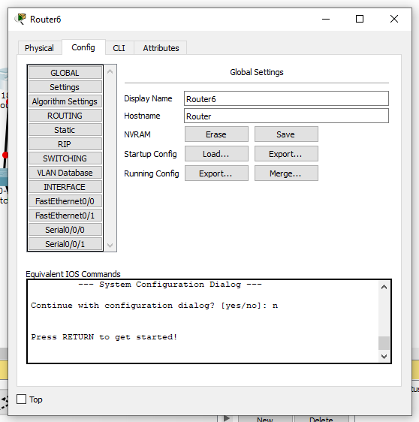
ROUTER BOOTED AND READY TO WORK ON

Slide 23
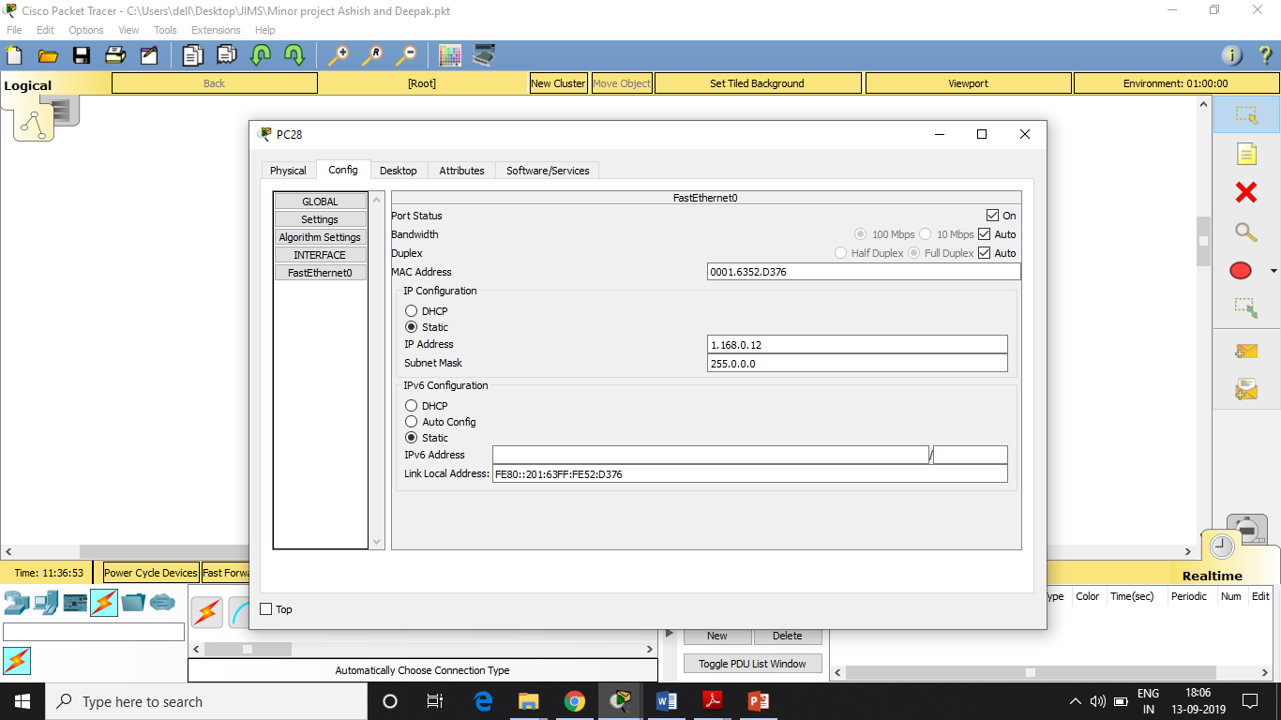
ALLOTING IP ADDRESS TO PC

Slide 24
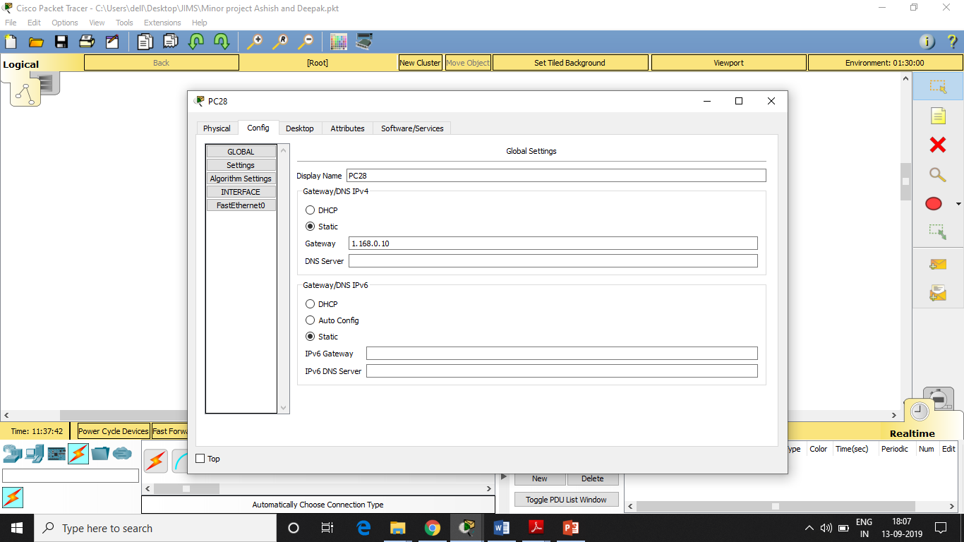
PROVIDING GATEWAY TO PC

Slide 25
PROVIDING GATEWAY IP TO ROUTER ALPHA FOR COMMUNICATION WITH PC
Router>enable
Router#configure terminal
Enter configuration commands, one per line. End with CNTL/Z.
Router(config)#interface FastEthernet0/0
Router(config)#interface FastEthernet0/0
Router(config-if)#ip address 1.168.0.10 255.0.0.0
Router(config-if)#no shutdown
Router(config-if)#
%LINK-5-CHANGED: Interface FastEthernet0/0, changed state to up
%LINEPROTO-5-UPDOWN: Line protocol on Interface FastEthernet0/0, changed state to up
Router(config-if)#exit

Slide 26
Router BETA Gateway Set
Router>enable
Router#configure terminal
Enter configuration commands, one per line. End with CNTL/Z.
Router(config)#interface FastEthernet0/0
Router(config-if)#ip address 192.168.0.20 255.255.255.0
Router(config-if)#no shutdown
Router(config-if)#
%LINK-5-CHANGED: Interface FastEthernet0/0, changed state to up
%LINEPROTO-5-UPDOWN: Line protocol on Interface FastEthernet0/0, changed state to up

Slide 27
Serial Port Enabling In Router ALPHA
//WICT2 Module
Router>enable
Router#configure terminal
Enter configuration commands, one per line. End with CNTL/Z.
Router(config)#interface Serial0/0/0
Router(config-if)#no ip address
Router(config-if)#ip address 10.0.0.1 255.0.0.0
Router(config-if)#no shutdown
%LINK-5-CHANGED: Interface Serial0/0/0, changed state to up

Slide 28
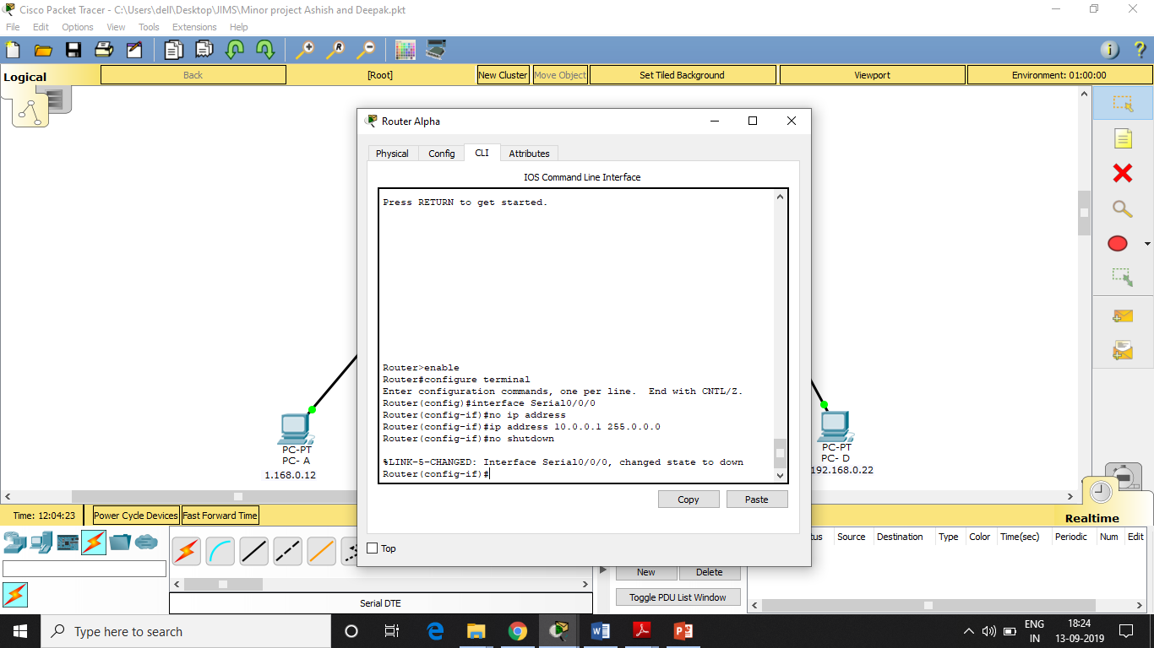

Slide 29
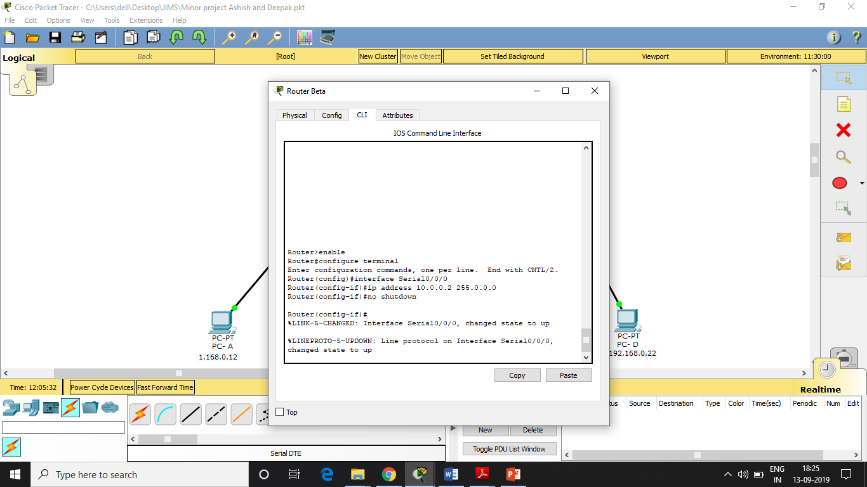
SERIAL PORT ENABLING IN ROUTER BETA

Slide 30
ROUTER BETA SERIAL PORT
Router>enable
Router#configure terminal
Enter configuration commands, one per line. End with CNTL/Z.
Router(config)#interface Serial0/0/0
Router(config-if)#ip address 10.0.0.2 255.0.0.0
Router(config-if)#no shutdown
Router(config-if)#
%LINK-5-CHANGED: Interface Serial0/0/0, changed state to up
%LINEPROTO-5-UPDOWN: Line protocol on Interface Serial0/0/0, changed state to up

Slide 31
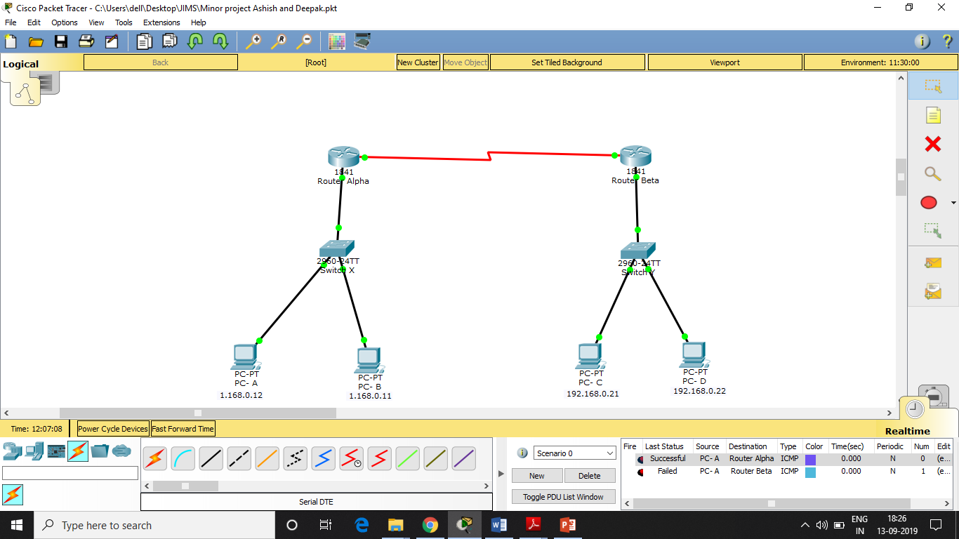
Without Routing Protocol Routers are not able to Communicate

Slide 32
Configuring RIP in Router ALPHA
Router(config)#router rip
Router(config-router)#network 10.0.0.0
Router(config-router)#
Router(config-router)#exit
Router(config)#router rip
Router(config-router)#network 1.0.0.0
Router(config-router)#
Router(config-router)#exit
Router(config)#router rip
Router(config-router)#network 192.168.0.0
Router(config-router)#
Router(config-router)#exit

Slide 33
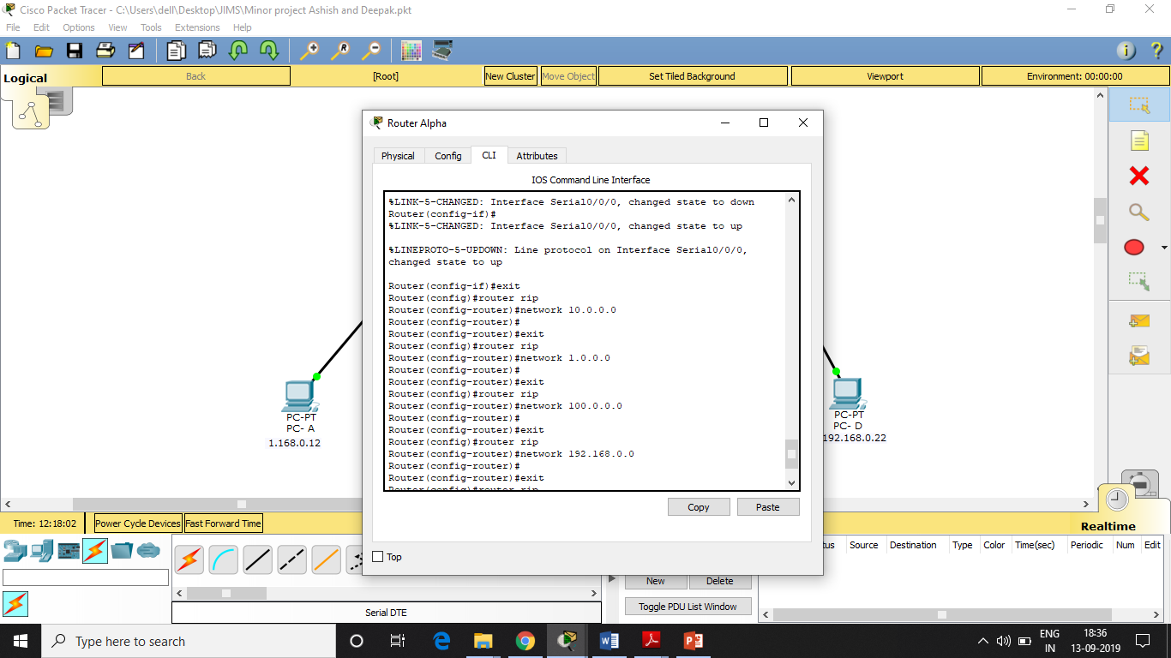

Slide 34
Configuring RIP in Router BETA
Router(config)#router rip
Router(config-router)#network 10.0.0.0
Router(config-router)#
Router(config-router)#exit
Router(config)#router rip
Router(config-router)#network 1.0.0.0
Router(config-router)#
Router(config-router)#exit
Router(config)#router rip
Router(config-router)#network 192.168.0.0
Router(config-router)#
Router(config-router)#exit

Slide 35


Slide 36
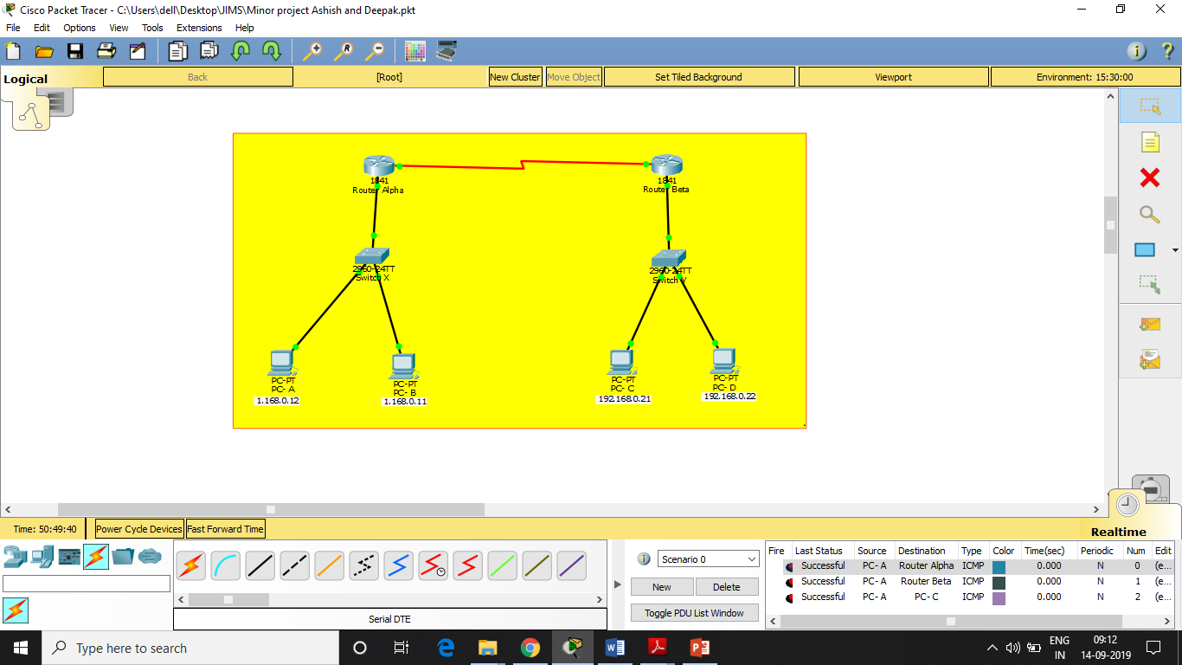
RIP WORKING – PC & Routers Able to Send and Receive Packages

Slide 37
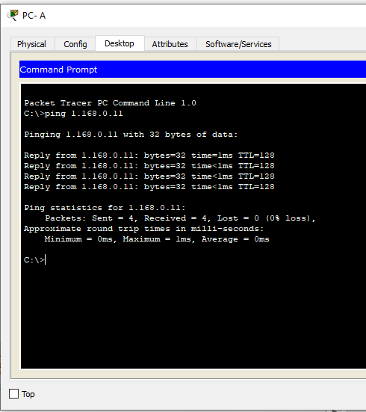
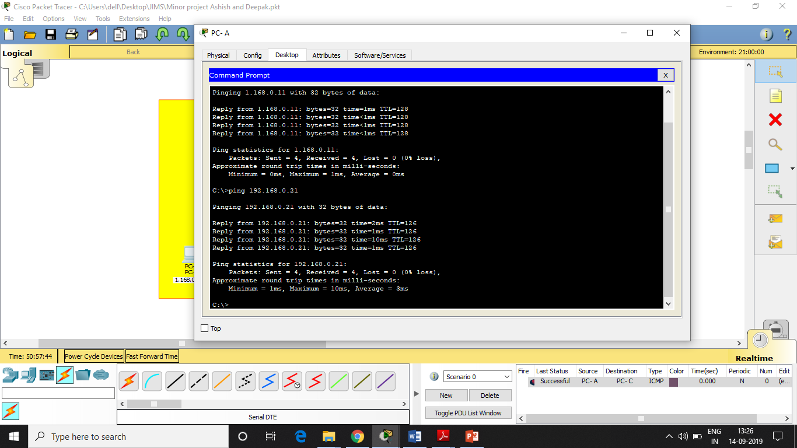

Slide 38
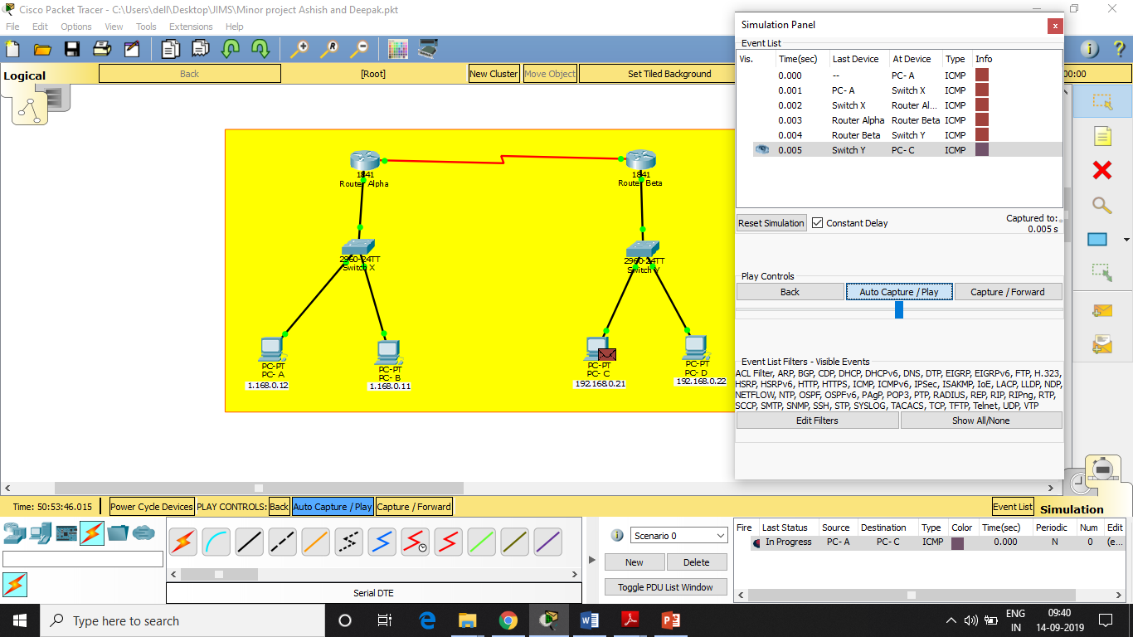
Simulation – Packet Sending & Receiving

Slide 39

Acknowledgment Received

Slide 40
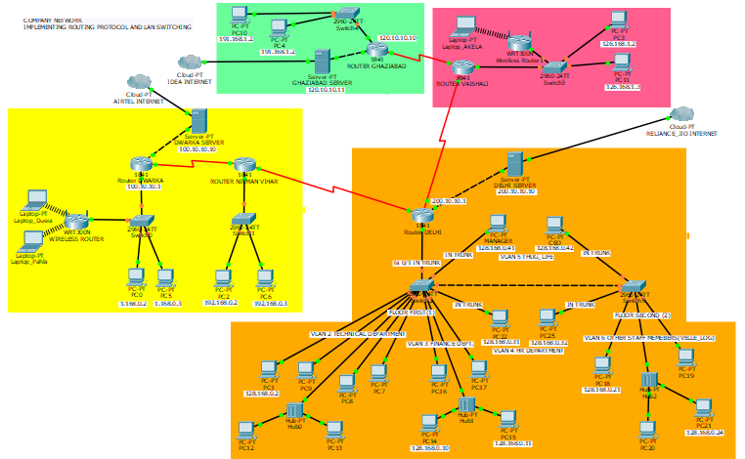
A COMPLEX SCENARIO

Slide 41

THANK YOU!!
ANY QUESTIONS?

